Slide 1
Lecture 1

Slide 2
Outline
Review
OSI Security Architecture
Attack model

Slide 3
Review
Security requirements
Integrity
Availability
Confidentiality
Authenticity
Accountability

Slide 4
Challenges to achieve a secure system
The mechanisms used to meet those requirements can be quite complex, and understanding them may evolve rather subtle reasoning
When developing security mechanisms, must always consider potential attacks
Sometimes, security mechanisms are counterintuitive
Where to use them?
Involve more than a particular algorithm or protocol
No agreement on security for complex and heterogeneous systems i.e. trusts on data in different countries
etc.

Slide 5
OSI Security Architecture

Slide 6
OSI Security Architecture
International Telecommunication Union – Telecommunication (ITU-T) recommends X.800
Security Architecture for Open Systems Interconnection (OSI)
Defines a systematic way of defining and providing security requirements
Used by IT managers and vendors in their products
Security attacks
Security mechanisms
a process (or a device incorporating such a process) to detect, prevent, or recover from an attack
Security services
enhances the security of the data processing systems and the information transfers, such as policies

Slide 7
Other Security Architectures
OWASP - Open Web Application Security Project
web application security
OWASP foundation
NIST, Cybersecurity Framework
https://www.nist.gov/cyberframework
VIRTUAL WORKSHOP #2 | February 15, 2023 (9:00 AM – 5:30 PM EST). Join us to discuss potential significant updates to the CSF as outlined in the soon-to-be-released CSF Concept Paper.
https://www.nist.gov/news-events/events/2023/02/journey-nist-cybersecurity-framework-csf-20-workshop-2

Slide 8
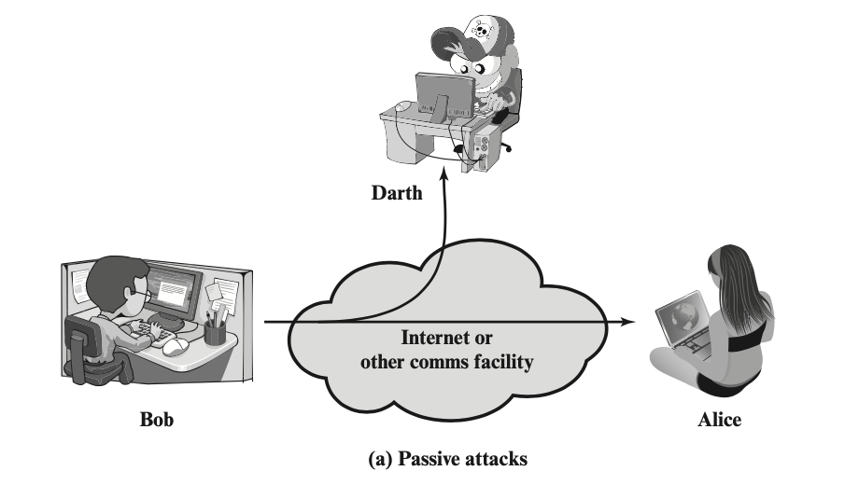
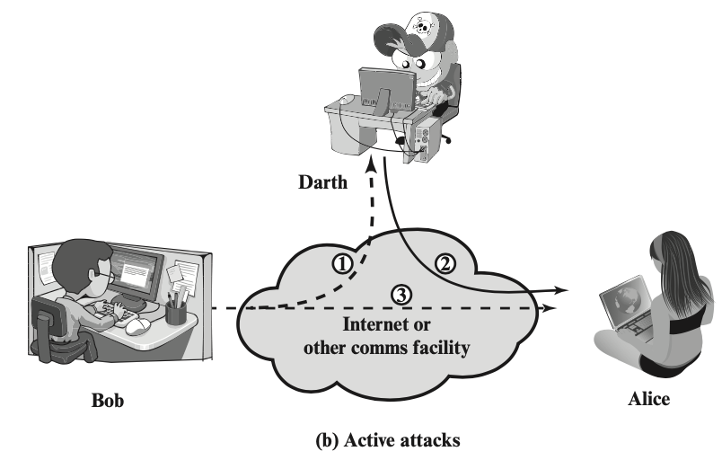
Security attack
Definition: any action that compromises the security of information owned by an organization
Two types of security attacks
Passive attack
Active attack

Slide 9
Passive attack
i.e. eavesdropping on or monitoring of transmissions
Goal: obtain information being transmitted
release of message contents
traffic analysis – a promiscuous sniffer
Very difficult to detect – no alteration of the data
But easy to prevent, why?

Slide 10
Active attack
active attack includes:
replay
Modification of messages
Denial of service
Masquerade

Slide 11
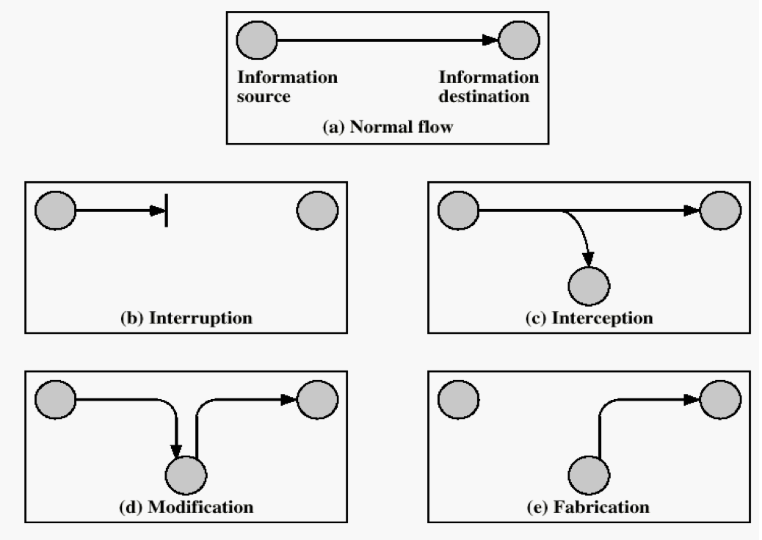
Example: two points communication
Generic types of attacks

Slide 12
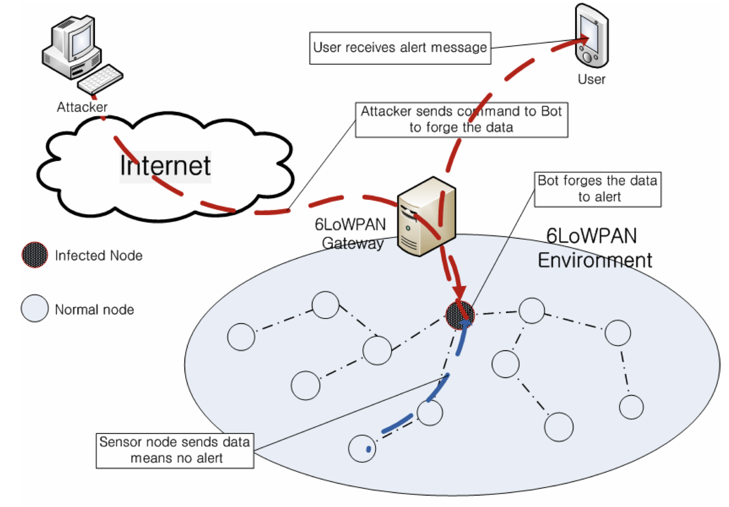
Example of modification attack in 6LoWPAN

Slide 13
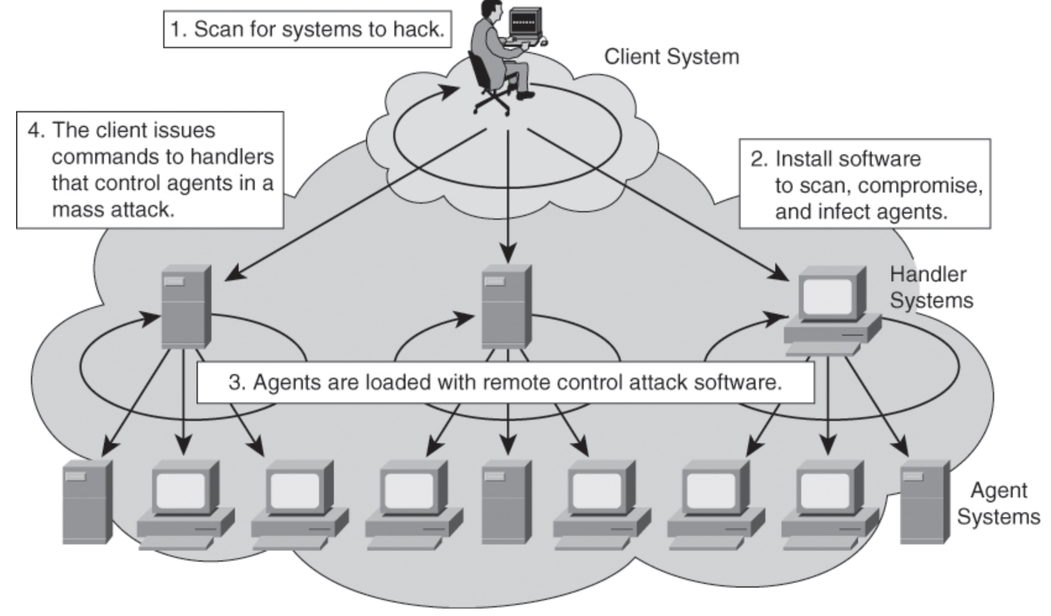
Example: a group of attackers

Slide 14
Know Your Threat Model
Threat model: A model of who your attacker is and what resources they have
One of the best ways to counter an attacker is to attack their reasons

Slide 15
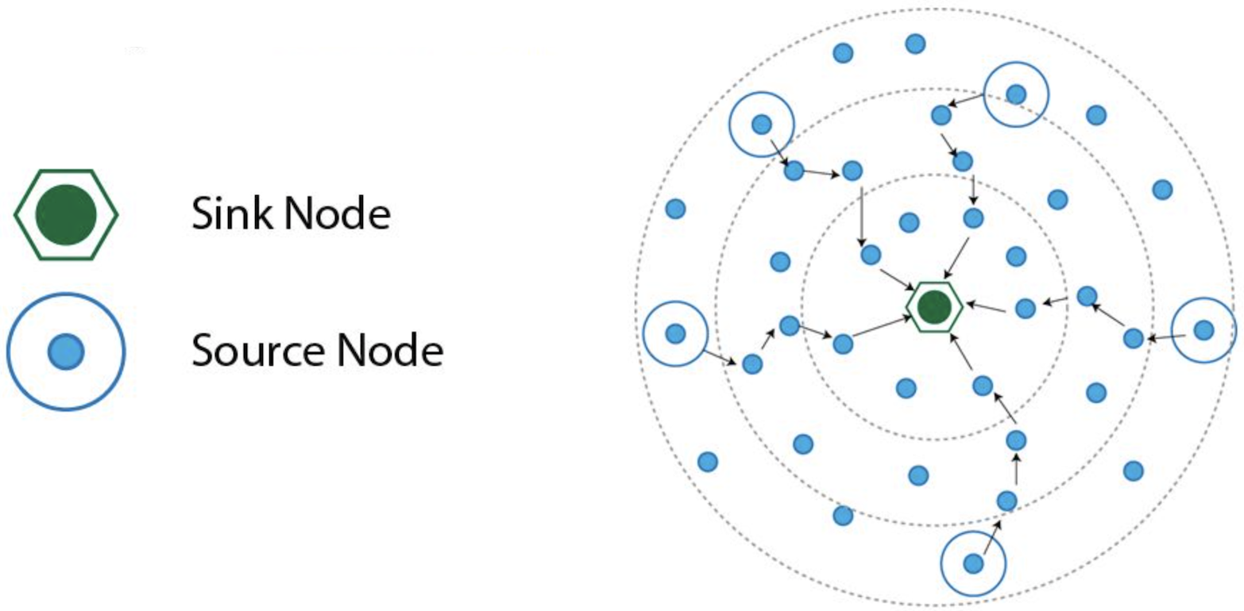
Example: adversary model
“The adversary is assumed to be intelligent and has limited number of resources. Before capturing the nodes, it exploits the various vulnerabilities of the networks. It knows the topology of the network, routing information. It aims to capture the sink node so as to disrupt the whole traffic. If it is not able to capture the sink node, it will capture the nearby nodes of the sink. It tries to disrupt the whole traffic of the network with minimum number of captured nodes. It is also assumed that the adversary tends to attack more on the nodes closer to the data sink than nodes that are far away”

Slide 16

Story…
The bear race
Takeaway: Even if a defense is not perfect, it is important to always stay on top of best security measures
I don’t have to outrun the bear. I just have to outrun you

Slide 17
Design in security from the start
When building a new system, include security as part of the design considerations rather than patching it after the fact
A lot of systems today were not designed with security from the start, resulting in patches that don’t fully fix the problem!
Keep these security principles in mind whenever you write code!

Slide 18
Human Factors
The users
Users like convenience (ease of use)
If a security system is unusable, it will be unused
Users will find way to subvert security systems if it makes their lives easier
The programmers
Programmers make mistakes
Programmers use tools that allow them to make mistakes (e.g. C and C++)
Everyone else
Social engineering attacks exploit other people’s trust and access for personal gain

Slide 19
Summary for Chapter 1
Have learned:
Security requirements
Attack models
X.800 secure architecture, security services, mechanisms

Slide 20
Supplementary materials
Internet Security Glossary, v2 – produced by Internet Society https://datatracker.ietf.org/doc/html/rfc4949
X.800 – OSI network security
https://www.itu.int/rec/dologin_pub.asp?lang=f&id=T-REC-X.800-199103-I!!PDF-E&type=items

Slide 21

Review Questions
William Stallings (WS), “Network Security Essentials”, 6th Global Edition
RQ 1.1 - 1.3
Prob 1.5

Slide 22
Symmetric encryption
Sender and recipient share a common/same key
Was the only type of cryptography, prior to invention of public-key in 1970’s

Slide 23
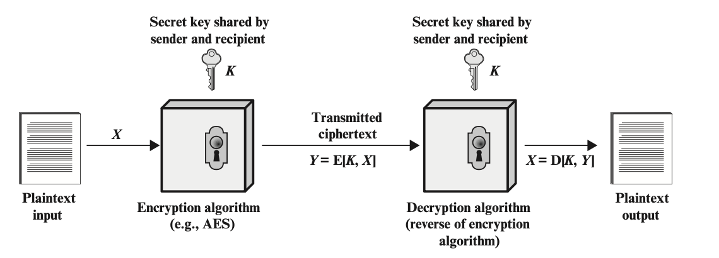
Simplified model of symmetric encryption

Slide 24
Symmetric encryption
Has five ingredients
Plaintext: the original message or data
Encryption algorithm: performs various substitutions and transformations on the plaintext
Secret key
Ciphertext: the coded message
Decryption algorithm: takes the ciphertext and the same secret key and produces the original plaintext

Slide 25
Other basic terminology
cipher - algorithm for transforming plaintext to ciphertext
encipher (encrypt) - converting plaintext to ciphertext
decipher (decrypt) - recovering plaintext from ciphertext
cryptography - study of encryption principles/methods
cryptanalysis (codebreaking) - the study of principles/ methods of deciphering ciphertext without knowing key

Slide 26
Requirements
Two requirements for secure use of symmetric encryption:
a strong encryption algorithm
a secret key known only to sender / receiver
Y = E_{K}(X)
X = D_{K}(Y)
assume encryption algorithm is known
the security of symmetric encryption depends on the secrecy of the key
implies a secure channel to distribute key

Slide 27
Requirements
Two requirements for secure use of symmetric encryption:
a strong encryption algorithm
a secret key known only to sender / receiver
Y = E_{K}(X)
X = D_{K}(Y)
assume encryption algorithm is known
the security of symmetric encryption depends on the secrecy of the key
implies a secure channel to distribute key

Slide 28
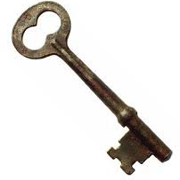
A strong encryption algorithm
plaintext / enquiry
cyphertext / response
attacker
encryption algorithm

Slide 29
Secure Encryption Scheme
Unconditional security
no matter how much computer power is available, the cipher cannot be broken since the ciphertext provides insufficient information to uniquely determine the corresponding plaintext
Computational security
the cost of breaking the cipher exceeds the value of the encrypted information;
or the time required to break the cipher exceeds the useful lifetime of the information

Slide 30
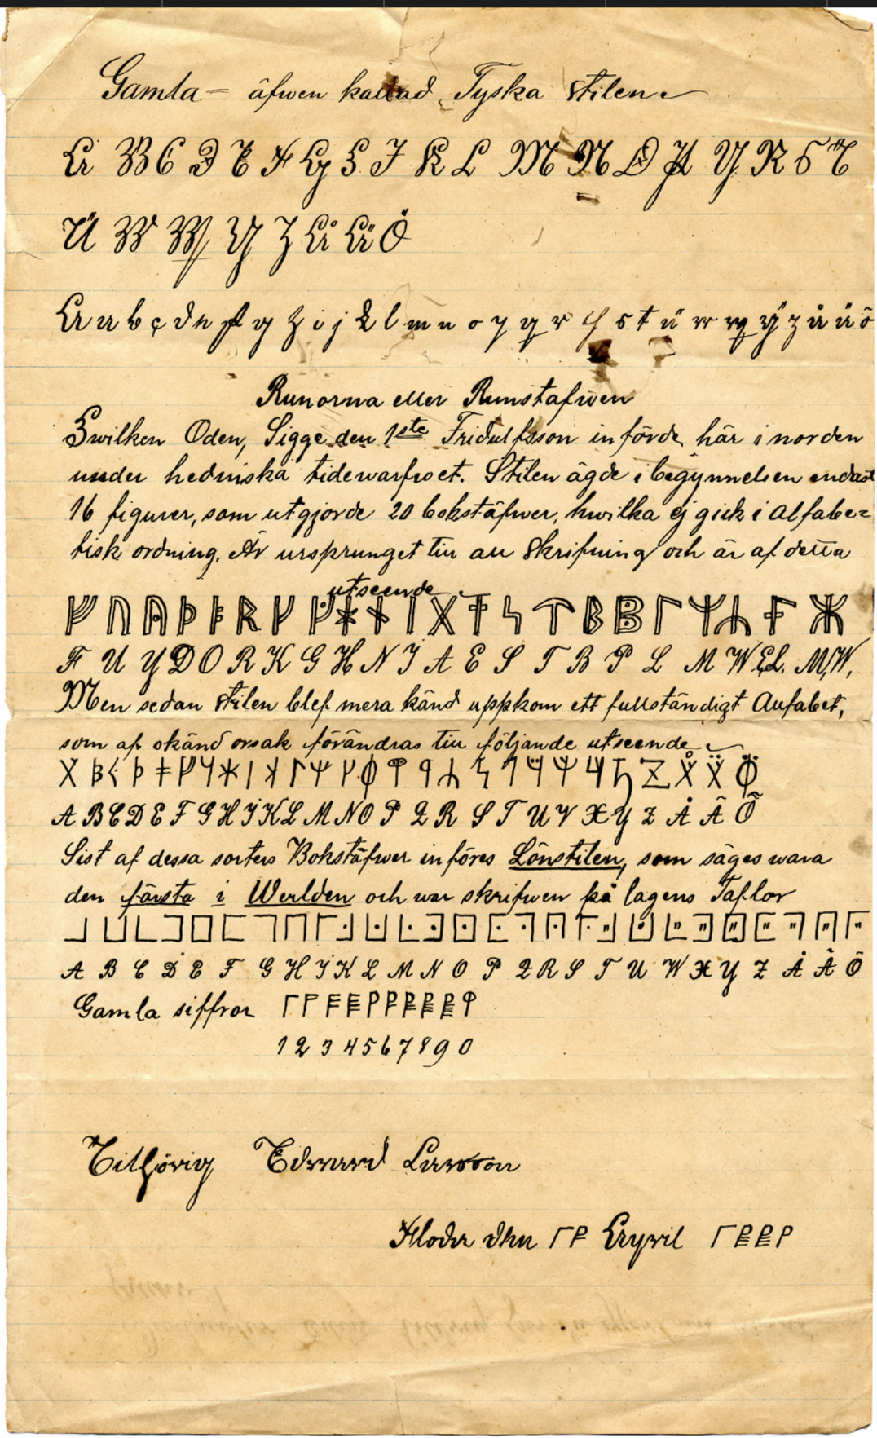

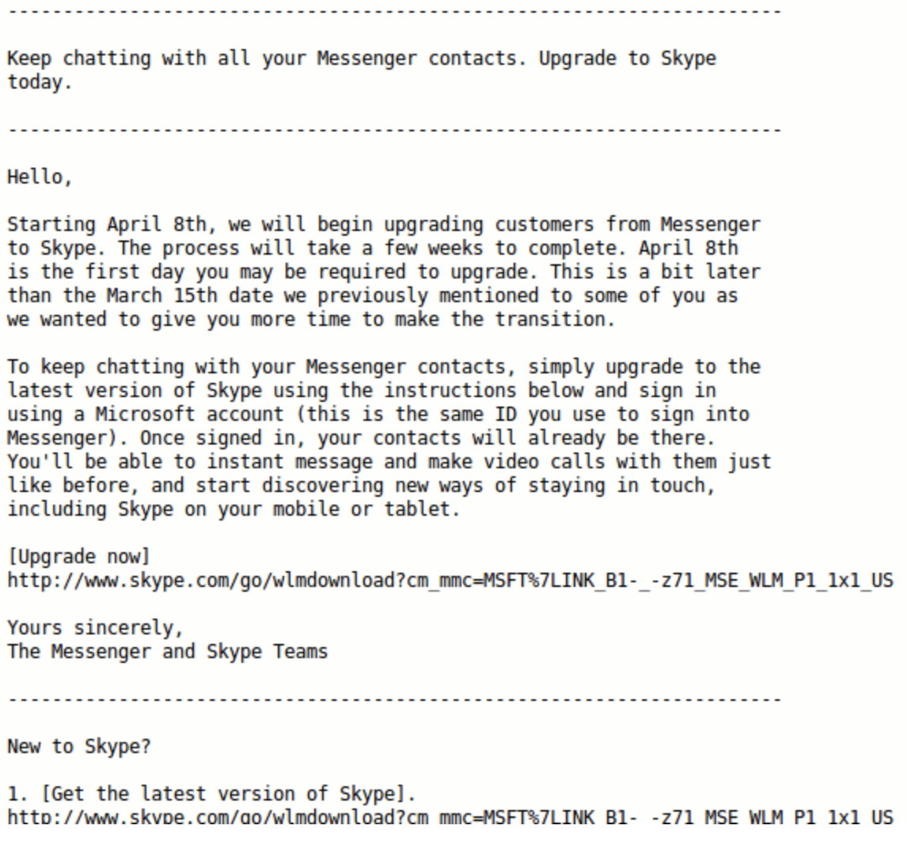
Desired characteristics
Cipher needs to completely obscure statistical properties of original message
more practically Shannon suggested combining elements to obtain:
Confusion – how does changing a bit of the key affect the ciphertext?
Diffusion – how does changing one bit of the plaintext affect the ciphertext?
confusion
ciphertext
diffusion
plaintext

Slide 31
Ways to achieve
Symmetric Encryption:
substitution / transposition / hybrid
Asymmetric Encryption:
Mathematical hardness - problems that are efficient to compute in one direction, but inefficient to reverse by the attacker
Examples: Modular arithmetic, factoring, discrete logarithm problem, Elliptic Logs over Elliptic Curves

Slide 32
Project
TA Name: Lin, Yu
Email: Yu.Lin@ttu.edu
Form a group (no submission)
•The project will be assigned as a group project. Six students will be considered a group for a project. Here is the link to enter your project group member names.
FALL 2023 CS5342 PROJECT GROUP NAMES.xlsx
•It is recommended that one person in the group fills in the form to avoid multiple entries and submits project files on Blackboard. If you cannot get a group, contact the TA.
Deadline to submit your group members is 11:59 PM on Sept 8th, 2023

Slide 33
Review
Strong Encryption Algorithm
Confusion
Diffusion

Slide 34
Block cipher
the most commonly used symmetric encryption algorithms
input: fixed-size blocks (Typically 64, 128 bit blocks), output: equal size blocks
provide secrecy and/or authentication services
Data Encryption Standard (DES), triple DES (3DES), and the Advanced Encryption Standard (AES)s
Usually employ Feistel structure

Slide 35
Feistel Cipher Structure
most symmetric block ciphers are based on a Feistel Cipher Structure
based on the two primitive cryptographic operations
substitution (S-box)
permutation (P-box)
provide confusion and diffusion of message

Slide 36
Feistel Cipher Structure
Horst Feistel devised the feistel cipher in the 1973
based on concept of invertible product cipher
partitions input block into two halves
process through multiple rounds which
perform a substitution on left data half
based on round function of right half & subkey
then have permutation swapping halves
implements Shannon’s substitution-permutation network concept

Slide 37
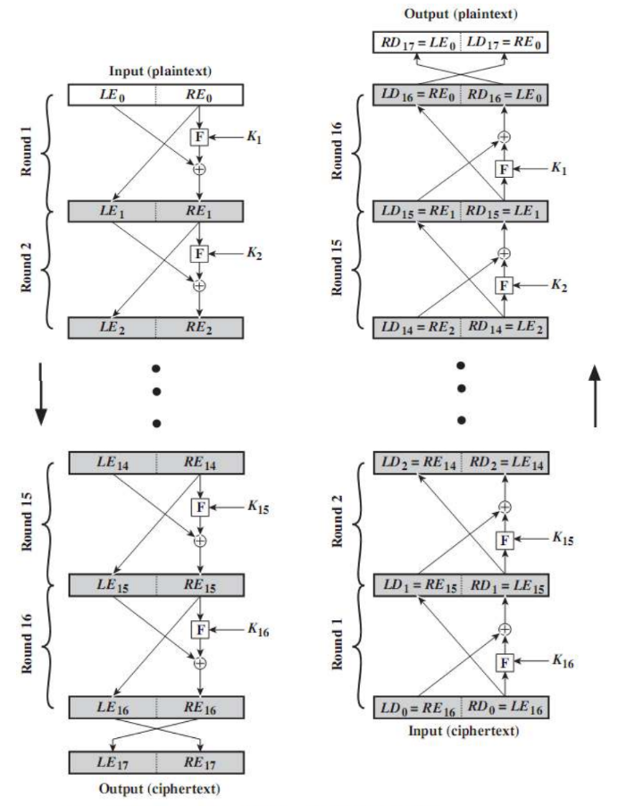
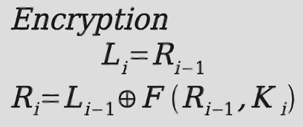
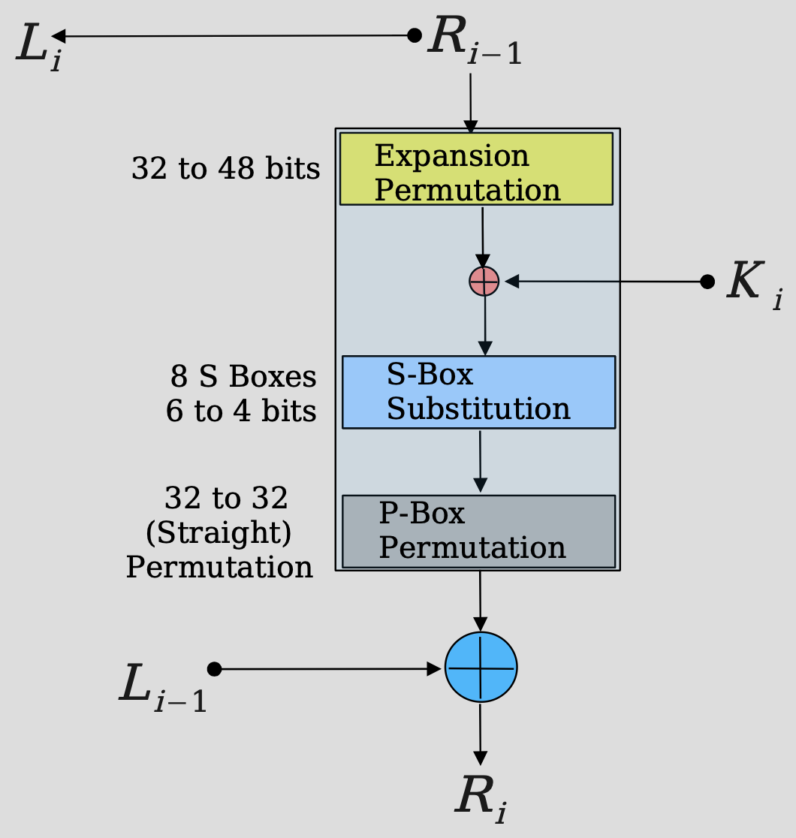
Feistel Encryption and Decryption

Slide 38
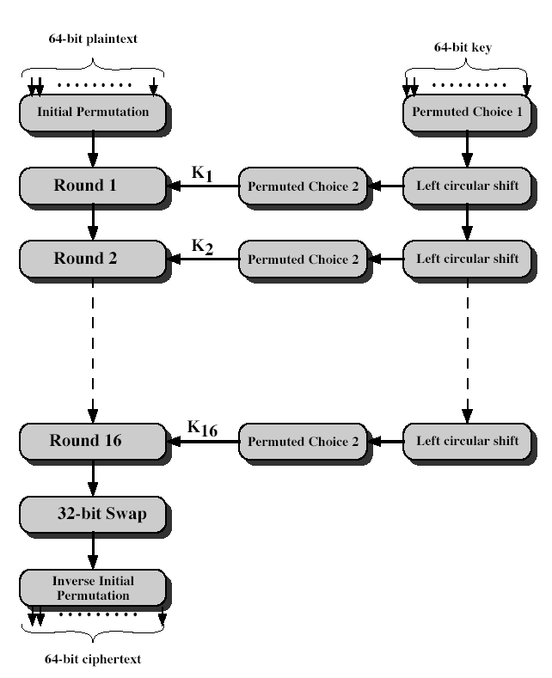
DES encryption
64 bits plaintext
56 bits effective key length

Slide 39
Outline
AES
Random number

Slide 40
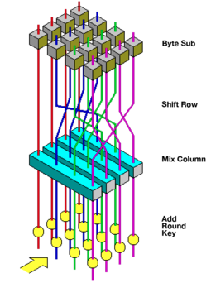
Rijndael
processes data as 4 groups of 4 bytes (state) = 128 bits
has 10/12/14 rounds in which state undergoes:
byte substitution (1 S-box used on every byte)
shift rows (permute bytes row by row)
mix columns (alter each byte in a column as a function of all of the bytes in the column)
add round key (XOR state with key material)
128-bit keys – 10 rounds, 192-bit keys – 12 rounds, 256-bit keys – 14 rounds

Slide 41
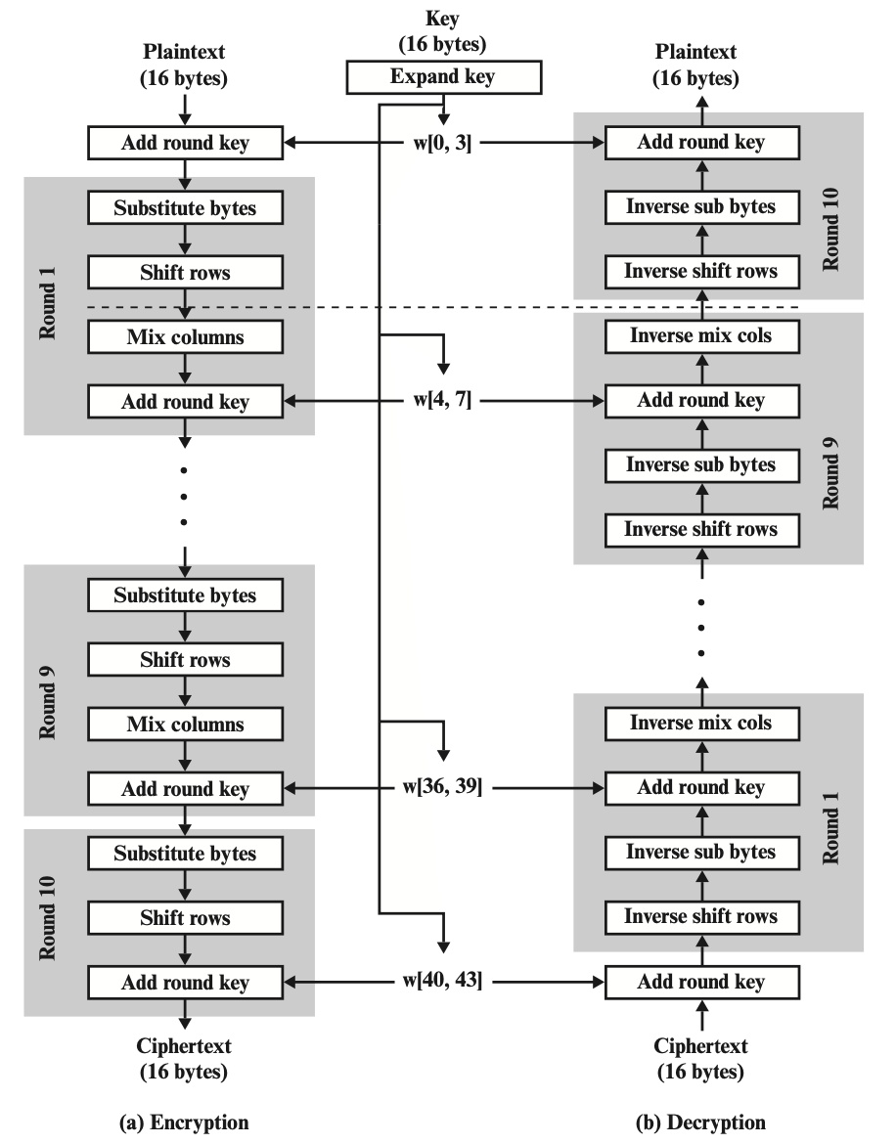
AES Encryption and Decryption

Slide 42
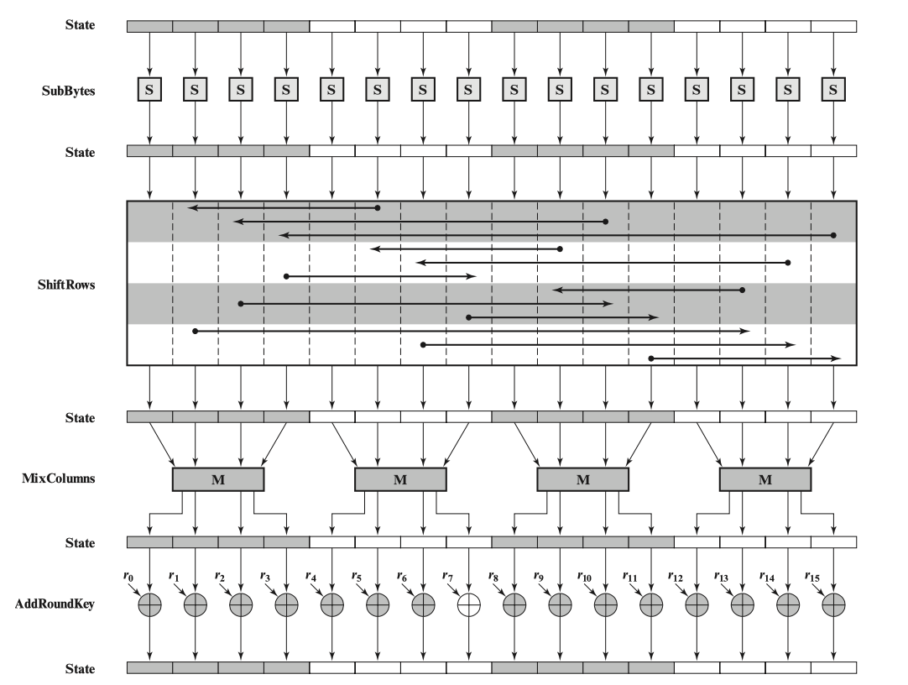
AES encryption round

Slide 43
AES pros
Most operations can be combined into XOR and table lookups - hence very fast & efficient

Slide 44
Take-home Exercises
Find an AES code to encrypt a text (A), then decrypt it and check whether the original text (A) equals the decrypted text (B). Whether A = B?
Compare the decryption time with different key lengths, and with DES and 3DES.
Suggestions: find a large A file. Run decryption a couple of times and take the average.

Slide 45
Reading materials
FIPS 197, Advanced Encryption Standard (AES) (nist.gov)

Slide 46
When to use random numbers?
Generation of a stream key for symmetric stream cipher
Generation of keys for public-key algorithms
RSA public-key encryption algorithm (described in Chapter 3)
Generation of a symmetric key for use as a temporary session key
used in a number of networking applications, such as Transport Layer Security (Chapter 5), Wi-Fi (Chapter 6), e-mail security (Chapter 7), and IP security (Chapter 8)
In a number of key distribution scenarios
Kerberos (Chapter 4)

Slide 47
Two types of random numbers
True random numbers:
generated in non-deterministic ways. They are not predictable and repeatable
Pseudorandom numbers:
appear random, but are obtained in a deterministic, repeatable, and predictable manner

Slide 48
Properties of Random Numbers
Randomness
Uniformity
distribution of bits in the sequence should be uniform
Independence
no one subsequence in the sequence can be inferred from the others
Unpredictable
satisfies the "next-bit test“

Slide 49
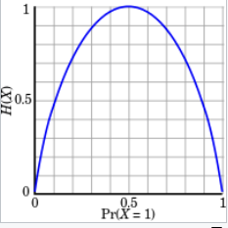
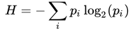
Entropy
A measure of uncertainty
In other words, a measure of how unpredictable the outcomes are
High entropy = unpredictable outcomes = desirable in cryptography
The uniform distribution has the highest entropy (every outcome equally likely, e.g. fair coin toss)
Usually measured in bits (so 3 bits of entropy = uniform, random distribution over 8 values)
Entropy of an information source

Slide 50
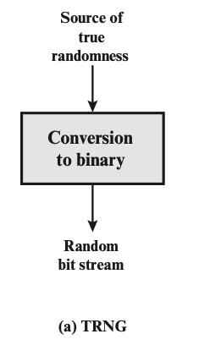
True random numbers generators
Several sources of randomness – natural sources of randomness
decay times of radioactive materials
electrical noise from a resistor or semiconductor
radio channel or audible noise
keyboard timings
disk electrical activity
mouse movements
Physical unclonable function (PUF)
Some are better than others

Slide 51
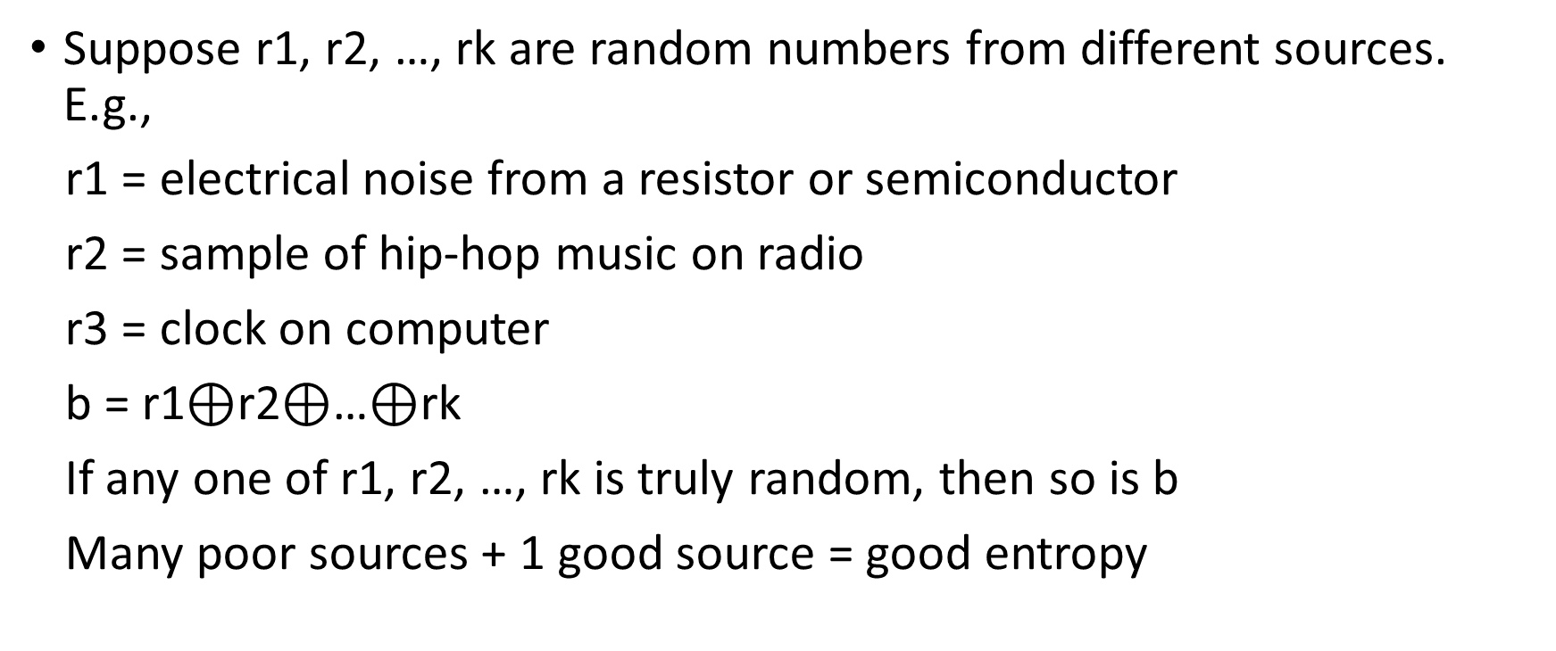
Combining sources of randomness
Suppose r1, r2, …, rk are random numbers from different sources. E.g.,
r1 = electrical noise from a resistor or semiconductor
r2 = sample of hip-hop music on radio
r3 = clock on computer
b = r1$⊕$r2$⊕$…$⊕$rk
If any one of r1, r2, …, rk is truly random, then so is b
Many poor sources + 1 good source = good entropy

Slide 52
Pseudorandom Number Generators (PRNGs)
True randomness is expensive
Pseudorandom number generator (PRNGs): An algorithm that uses a little bit of true randomness to generate a lot of random-looking output
Also called deterministic random bit generators (DRBGs)
PRNGs are deterministic: Output is generated according to a set algorithm
However, for an attacker who can’t see the internal state, the output is computationally indistinguishable from true randomness

Slide 53
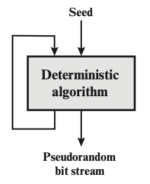
PRNG: Definition
A PRNG has two functions:
PRNG.Seed(randomness): Initializes the internal state using the entropy
Input: Some truly random bits
PRNG.Generate(n): Generate n pseudorandom bits
Input: A number n
Output: n pseudorandom bits
Updates the internal state as needed
Properties
Correctness: Deterministic
Efficiency: Efficient to generate pseudorandom bits
Security: Indistinguishability from random
Rollback resistance: cannot deduce anything about any previously-generated bit

Slide 54
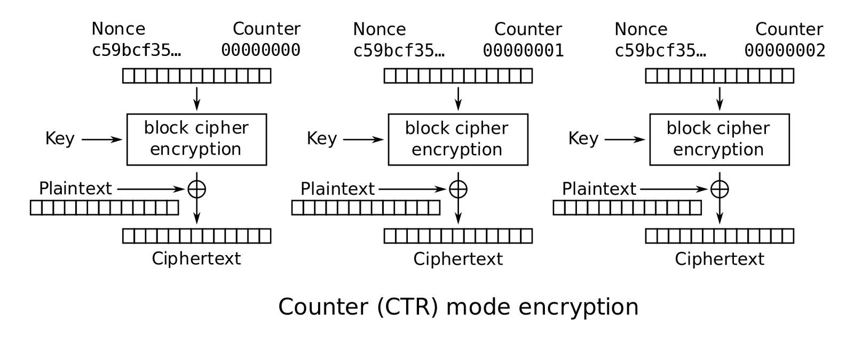
Example construction of PRNG
Using block cipher in Counter (CTR) mode:
If you want m random bits, and a block cipher with E_{k} has n bits, apply the block cipher m/n times and concatenate the result:
PRNG.Seed(K | IV) = E_{k}(IV, 1) | E_{k}(IV, 2) | E_{k}(IV, 3) … E_{k}(IV, ceil(m/n)),
| is concatenation
Initialization vector (IV) / Nonce – typically is random or pseudorandom
Randomness,
PRNG output

Slide 55
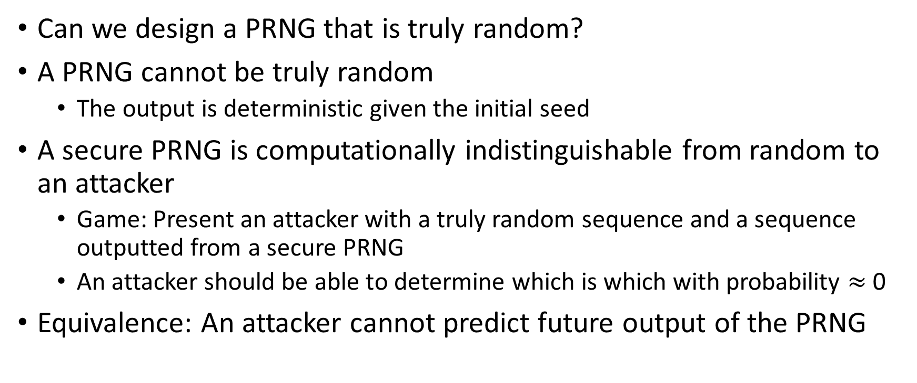
PRNG: Security
Can we design a PRNG that is truly random?
A PRNG cannot be truly random
The output is deterministic given the initial seed
A secure PRNG is computationally indistinguishable from random to an attacker
Game: Present an attacker with a truly random sequence and a sequence outputted from a secure PRNG
An attacker should be able to determine which is which with probability $≈$ 0
Equivalence: An attacker cannot predict future output of the PRNG

Slide 56
Create pseudorandom numbers
Truly random numbers are impossible with any program!
However, we can generate seemingly random numbers, called pseudorandom numbers
The function rand() returns a non-negative number between 0 and RAND_MAX
For C, it is defined in stdlib.h

Slide 57
PRNGs: Summary
True randomness requires sampling a physical process
PRNG: An algorithm that uses a little bit of true randomness to generate a lot of random-looking output
Seed(entropy): Initialize internal state
Generate(n): Generate n bits of pseudorandom output
Security: computationally indistinguishable from truly random bits

Slide 58
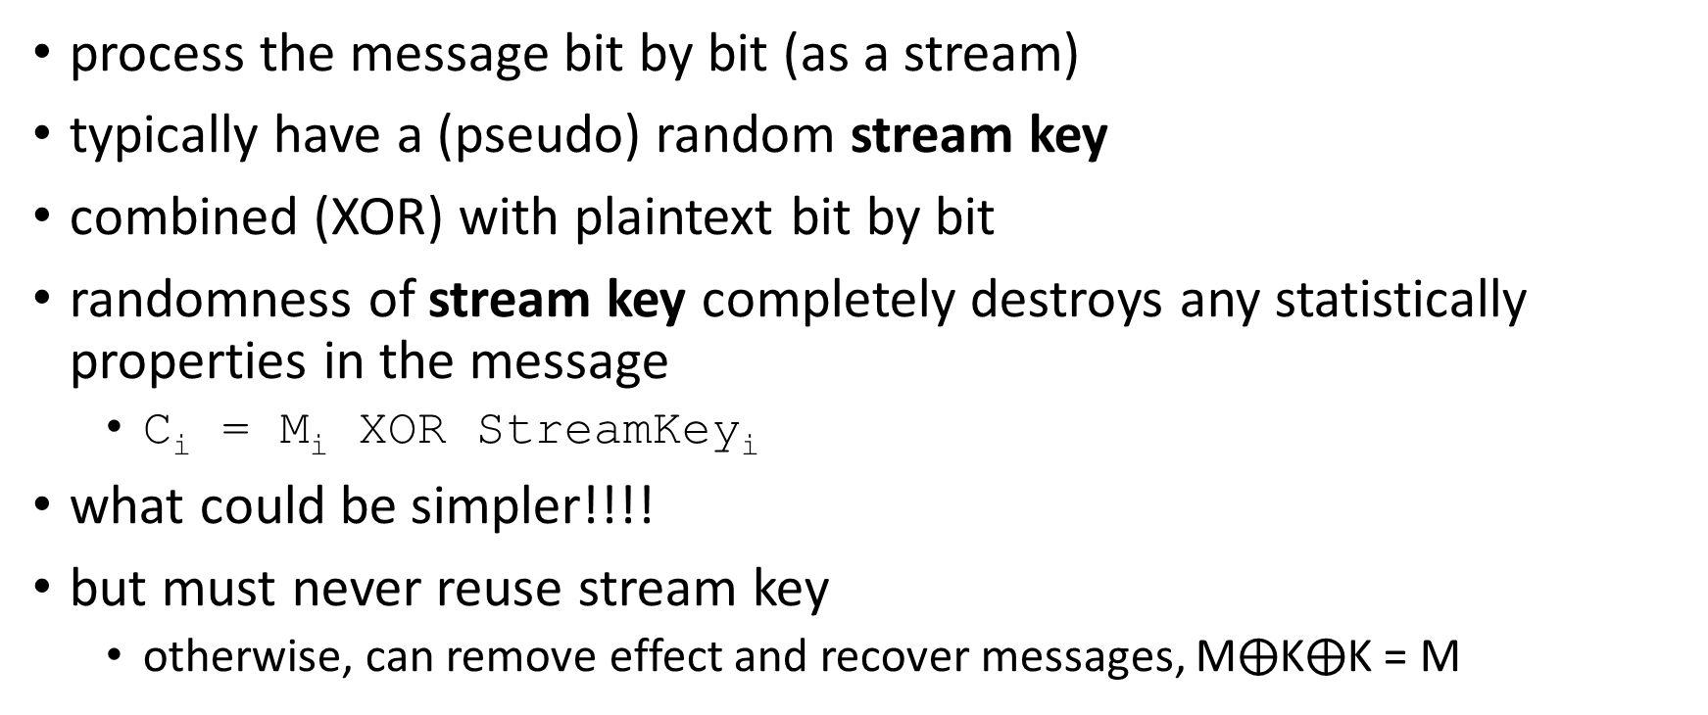
Stream Ciphers
process the message bit by bit (as a stream)
typically have a (pseudo) random stream key
combined (XOR) with plaintext bit by bit
randomness of stream key completely destroys any statistically properties in the message
C_{i} = M_{i} XOR StreamKey_{i}
what could be simpler!!!!
but must never reuse stream key
otherwise, can remove effect and recover messages, M$⨁$K$⨁$K = M

Slide 59
Stream Ciphers
Idea: replace “rand” by “pseudo rand”
Use Pseudo Random Number Generator
A secure PRNG produces output that looks indistinguishable from random
An attacker who can’t see the internal PRNG state can’t learn any output
PRNG: {0,1}^{s} → {0,1}^{n}
expand a short (e.g., 128-bit) random seed into a long (typically unbounded) string that “looks random”
Secret key is the seed
Basic encryption method: E_{key}[M] = M ⊕ PRNG(key)

Slide 60


Stream Ciphers
Protocol: Alice and Bob both seed a secure PRNG with their symmetric secret key, and then use the output as the key for stream key
Alice
Bob
Seed(k)
Seed(k)
Generate(n)
Generate(n)
Plaintext
$$⊕$$
Ciphertext
$$⊕$$
Plaintext

Slide 61
How to generate Stream Key?
How to generate Stream Key?

Slide 62
Stream Ciphers
Protocol: Alice and Bob both seed a secure PRNG with their symmetric secret key, and then use the output as the key for stream key
Alice
Bob
Seed(k)
Seed(k)
Generate(n)
Generate(n)
Plaintext
$$⊕$$
Ciphertext
$$⊕$$
Plaintext

Slide 63
Stream Ciphers: Encrypting Multiple Messages
How do we encrypt multiple messages without key reuses?
Alice
Bob
Seed(k)
Seed(k)
Generate(n)
Generate(n)
Plaintext
$$⊕$$
Ciphertext
$$⊕$$
Plaintext

Slide 64
Stream Ciphers: Encrypting Multiple Messages
Solution: For each message, seed the PRNG with the key and a random IV, concatenated(“|”). Send the IV with the ciphertext
Alice
Bob
IV
IV
Seed(k | IV)
Seed(k | IV)
Generate(n)
Generate(n)
Plaintext
$$⊕$$
Ciphertext
$$⊕$$
Plaintext

Slide 65
Real-world example: RC4
A proprietary cipher designed in 1987
Extremely simple but effective!
Very fast - especially in software
Easily adapts to any key length, byte-oriented stream cipher
Uses that permutation to scramble input info processed a byte at a time
Widely used (web SSL/TLS, wireless WEP, WPA)

Slide 66

RC4 Stream Cipher
key
(seed)
key stream
(pseudo random sequence)
RC4 (K|IV)
K
011010010111
$$⊕$$
C
ciphertext
M
message

Slide 67
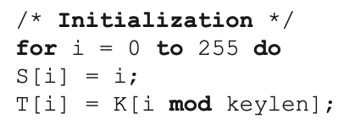
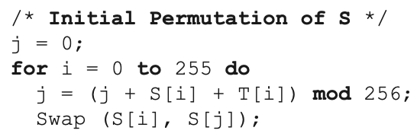
RC4 Key Schedule
starts with an array S of numbers: 0…255
use key to well and truly shuffle
S forms internal state of the cipher
given a key k of length L bytes
Throw away T & K, retain S

Slide 68
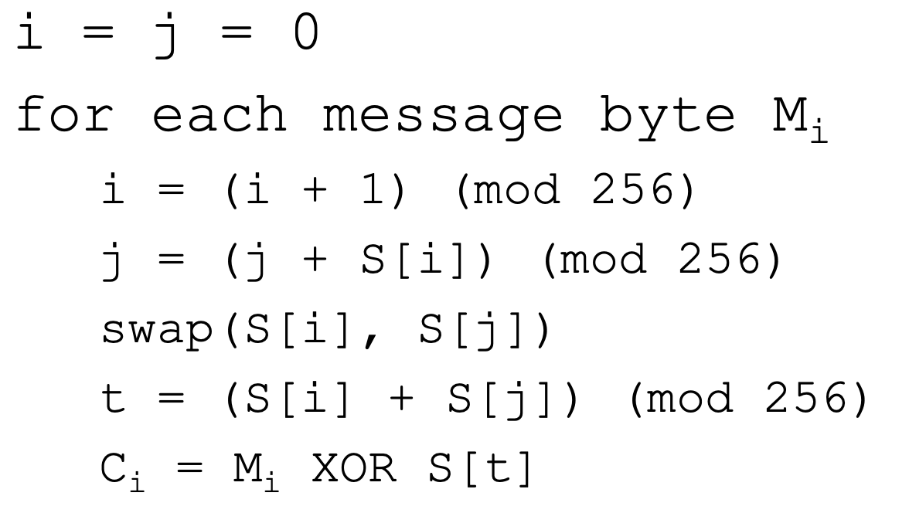
RC4 Encryption
encryption continues shuffling array values
sum of shuffled pair selects "stream key" value
XOR with next byte of message to en/decrypt

Slide 69
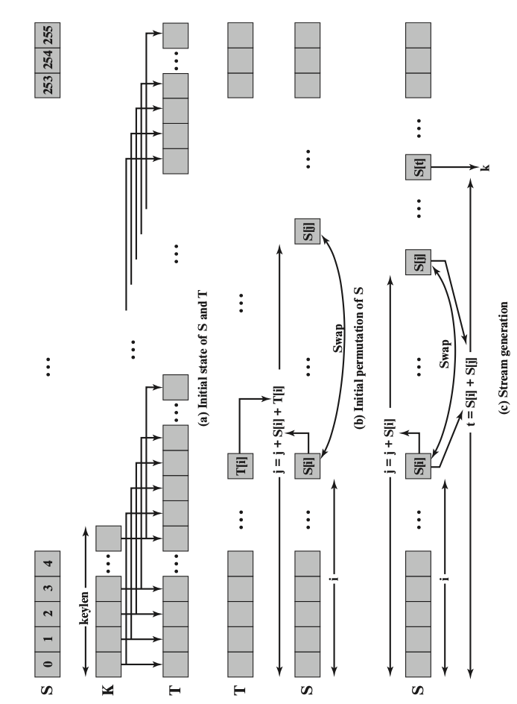
RC4

Slide 70
Summary – Chapter 2
Symmetric block cipher
DES, 3DES
AES
Random number
true random number
pseudorandom number
Stream cipher
The security of symmetric encryption depends on the secrecy of the key

Slide 71
Homework 1 - individual
For Chapter 1 & 2
Deadline: Oct. 2 (Monday), 11:59 pm
We will use the blackboard submission time as your final timestamp
10% penalty per day for late submission

Slide 72
Network Security
Chapter 3
Public-Key Cryptography and Message Authentication

Slide 73
Conventional cryptography
traditional private/secret/single-key cryptography uses one key
shared by both sender and receiver
if this key is disclosed communications are compromised
also is symmetric, parties are equal

Slide 74
Pros and cons
Pros:
Encryption is fast for large amounts of data
Provide the same level of security with a shorter encryption key
By now, it’s unbreakable to quantum computing
Cons
Key distribution assumes a secure channel
Does not protect sender from receiver forging a message & claiming it’s sent by sender
It does not scale well for large networks. It requires a separate key for each pair of communicating parties, which can result in a large number of keys to manage and protect.

Slide 75
Public-Key Cryptography
In public-key schemes, each person has two keys
Public key: Known to everybody
Private key: Only known by that person
Keys come in pairs: every public key corresponds to one private key
Uses number theory
Examples: Modular arithmetic, factoring, discrete logarithm problem, Elliptic logs over Elliptic Curves
Contrast with symmetric-key cryptography (uses XORs and bit-shifts)
Messages are numbers
Contrast with symmetric-key cryptography (messages are bit strings)

Slide 76
Public-key Cryptography
Benefit: No longer need to assume that Alice and Bob already share a secret
Benefit:
Drawback:
Drawback: Much slower than symmetric-key cryptography
Number theory calculations are much slower than XORs and bit-shifts

Slide 77
Reading materials
Encryption: Strengths and Weaknesses of Public-key Cryptography
Public-key cryptography is a public invention due to Whitfield Diffie & Martin Hellman at Stanford Uni in 1976

Slide 78
Public-key cryptography
public-key/two-key/asymmetric cryptography involves the use of two keys:
a public key, which may be known by anybody, and can be used to encrypt messages, and verify signatures
a private-key, known only to the recipient, used to decrypt messages, and sign (create) signatures
is asymmetric because
Not the same key
those who encrypt messages or verify signatures cannot decrypt messages or create signatures
Private key

Slide 79



Public-Key Encryption
Everybody can encrypt with the public key
Only the recipient can decrypt with the private key

Slide 80
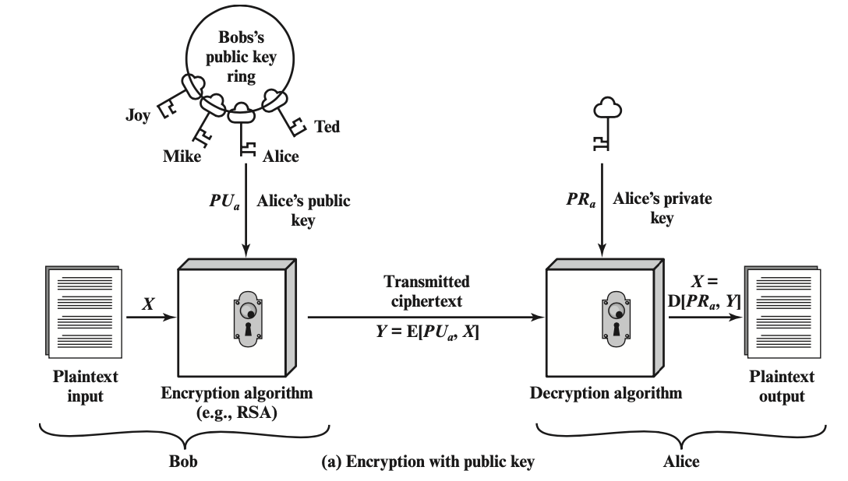
Public-Key Cryptography - Encryption

Slide 81
Encryption steps
step1: generate a pair of keys
step2: keep the private key / secret key (SK) and distribute the public key (PK) – place PK in a public register or other accessible file
step3: Bob encrypts the message with Alice’s PK
step4: upon receiving the ciphertext (CT), Alice decrypt CT with SK

Slide 82
Public-Key Encryption: Definition
Three parts:
KeyGen() → PK, SK: Generate a public/private keypair, where PK is the public key, and SK is the private (secret) key
Enc(PK, M) → C: Encrypt a plaintext M using public key PK to produce ciphertext C
Dec(SK, C) → M: Decrypt a ciphertext C using secret key SK
Properties
Correctness: Decrypting a ciphertext should result in the message that was originally encrypted
Dec(SK, Enc(PK, M)) = M for all PK, SK ← KeyGen() and M
Efficiency: Encryption/decryption should be fast
Security: 1. Alice (the challenger) just gives Eve (the adversary) the public key, and Eve doesn’t request encryptions. Eve cannot guess out anything; 2. computationally infeasible to recover M with PK and ciphertext

Slide 83
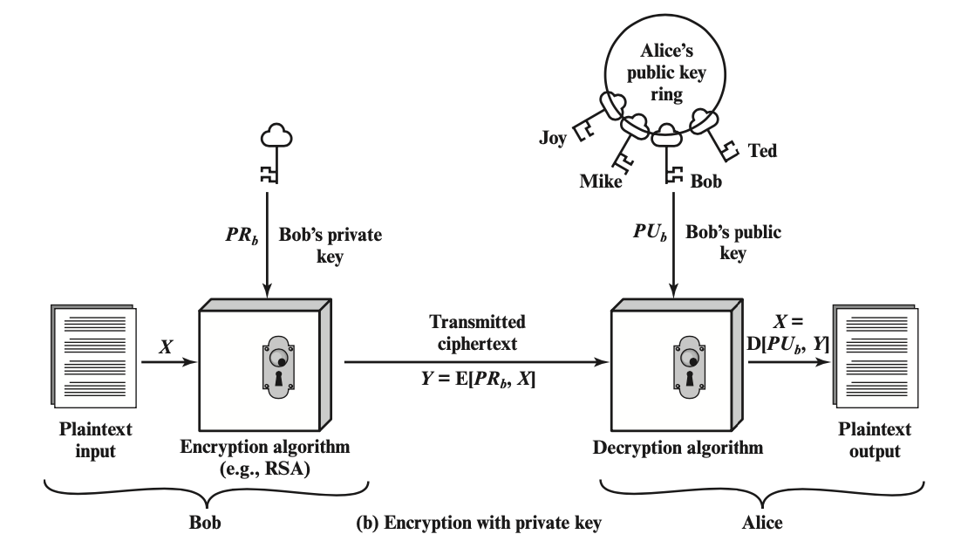
Public-Key Cryptography - Signature

Slide 84
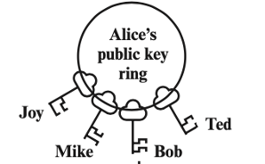

Review
Public Key
Encryption
Private Key
Signature

Slide 85
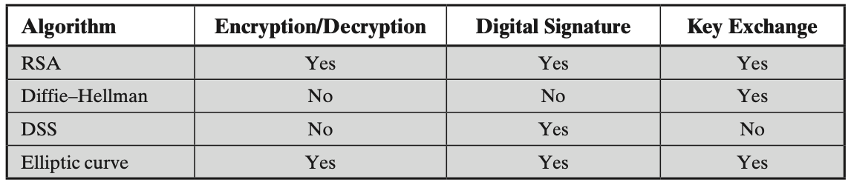
Public-Key application
can classify uses into 3 categories:
encryption/decryption (provide secrecy)
digital signatures (provide authentication)
key exchange (of session keys)
some algorithms are suitable for all uses; others are specific to one
Either of the two related keys can be used for encryption, with the other used for decryption

Slide 86
Network Security
Introduction
Chapter 1

Slide 87
Learning Objective
Introduce the security requirements
confidentiality
integrity
availability
Describe the X.800 security architecture for OSI

Slide 88
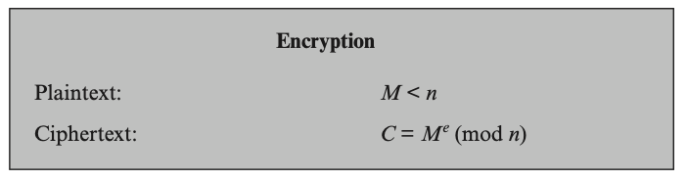
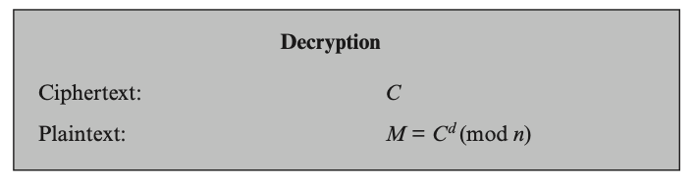
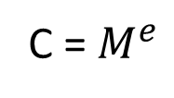
RSA use
to encrypt a message M the sender:
obtains public key of recipient pk={e,n}
computes: C=Me mod n, where 0≤M<n
to decrypt the ciphertext C the owner:
uses their private key sk={d,p,q}
computes: M=C^{d} mod n
note that the message M must be smaller than the modulus n (block if needed)
C = $M^{e}$
Plaintext
Ciphertext
pk={e,n}
sk={d,p,q}

Slide 89
RSA example continue
sample RSA encryption/decryption is:
given message M = 88 ( 88<187)
encryption:
C = 88⁷ mod 187 = 11
decryption:
M = 11²³ mod 187 = 88

Slide 90
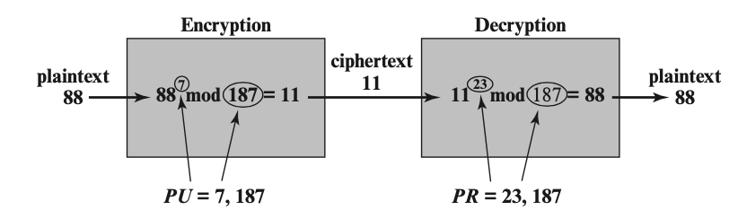
Example of RSA algorithm

Slide 91
RSA key generation
users of RSA must:
determine two primes at random - p, q
select either e or d and compute the other
primes p,q must not be easily derived from modulus n=p.q
means must be sufficiently large
typically guess and use probabilistic test
exponents e, d are inverses, so use Inverse algorithm to compute the other

Slide 92
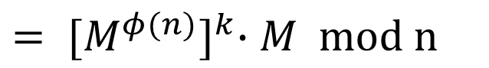
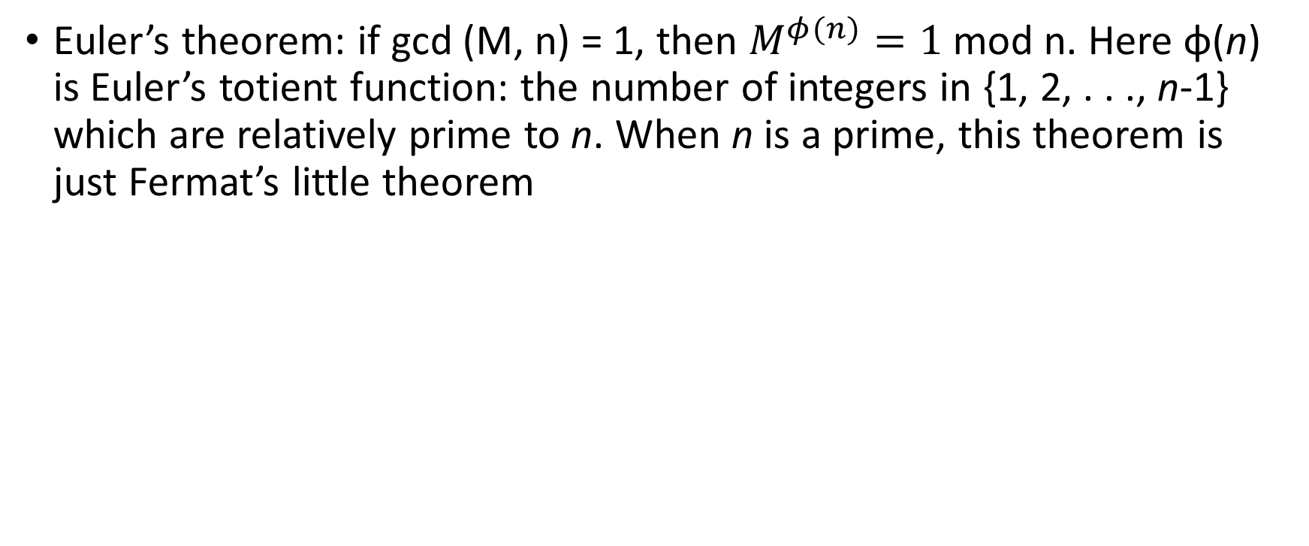
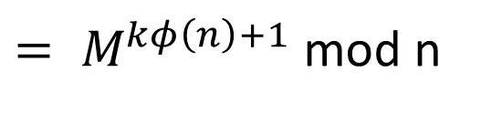
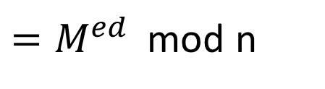
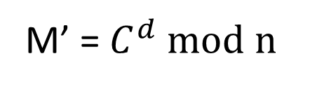
Correctness of RSA
Euler’s theorem: if gcd (M, n) = 1, then $M^{φ(n)}=1$mod n. Here φ(n) is Euler’s totient function: the number of integers in {1, 2, . . ., n-1} which are relatively prime to n. When n is a prime, this theorem is just Fermat’s little theorem
M’ = $C^{d}$ mod n
$=M^{ed }$ mod n
${= M}^{kφ\left(n\right)+1}$mod n
$${= [M^{φ(n)}]}^{k}∙M mod n$$
= M mod n

Slide 93
Attack approaches
Mathematical attacks: several approaches, all equivalent in effort to factoring the product of two primes. The defense against mathematical attacks is to use a large key size.
Timing attacks: These depend on the running time of the decryption algorithm
Chosen ciphertext attacks: this type of attacks exploits properties of the RSA algorithm by selecting blocks of data. These attacks can be thwarted by suitable padding of the plaintext, such as PKCS1 V1.5 in SSL

Slide 94
Homomorphic encryption
Encryption scheme that allows computation on ciphertexts
i.e. a public-key encryption scheme that allows anyone in possession of the public key to perform operations on encrypted data without access to the decryption key
Initial public-key systems that allow this for either addition or multiplication, but not both.
Fully homomorphic encryption (FHE)

Slide 95


Application of homomorphic encryption
One Use case: cloud computing
A weak computational device Alice (e.g., a mobile phone or a laptop) wishes to perform a computationally heavy task, beyond her computational means. She can delegate it to a much stronger (but still feasible) machine Bob (the cloud, or a supercomputer) who offers the service of doing so. The problem is that Alice does not trust Bob, who may give the wrong answer due to laziness, fault, or malice.
E (Pk, data)
E (Pk, f(data))

Slide 96
RSA reading materials
A Method for Obtaining Digital Signatures and Public-Key Cryptosystems

Slide 97
Lecture 15

Slide 98
Message Authentication

Slide 99
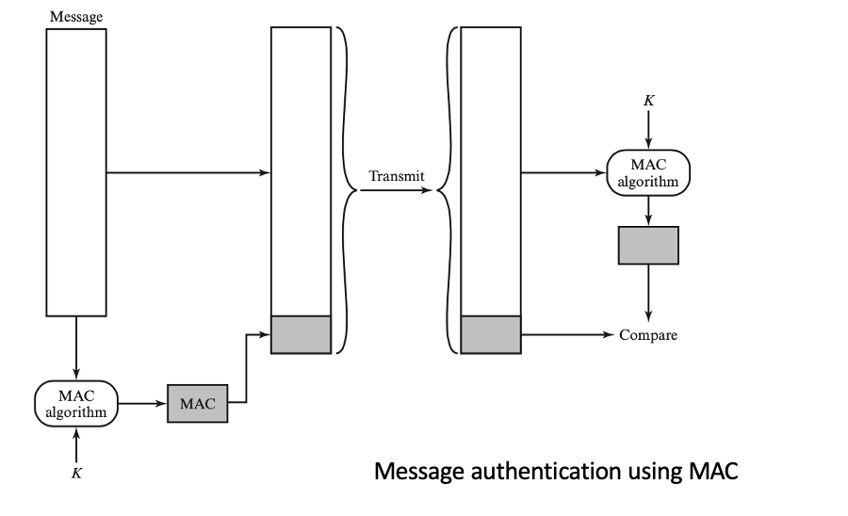
Message authentication
message authentication is concerned with:
protecting the integrity of a message
validating identity of originator
non-repudiation of origin (dispute resolution)
then three alternative functions used:
message encryption - symmetric
message authentication code (MAC)
digital signature

Slide 100
Message encryption
Symmetric message encryption by itself also provides a measure of authentication
if symmetric encryption is used then:
receiver knows sender must have created it
since only sender and receiver know key used
know content cannot be altered

Slide 101
Homework 1 questions
Q1: Symmetric Block Cypher provides authentication and confidentiality
Ans: True

Slide 102
Message encryption
if public-key encryption is used:
encryption provides no confidence of sender
since anyone potentially knows public-key
so, need to recognize corrupted messages
however, if
sender signs message using their private-key
then encrypts with recipients’ public key
have both secrecy and authentication
but at cost of two public-key uses on message

Slide 103
Reasons to avoid encryption authentication
Encryption software is quite slow
Encryption hardware costs are nonnegligible
Encryption hardware is optimized toward large data sizes
An encryption algorithm may be protected by a patent

Slide 104
Hash Function

Slide 105
Hash functions
Hash function: h = H(M)
M can be of any size
h is always of fixed size
Typically, h << size(M)

Slide 106
Lecture 16

Slide 107
Hash Function

Slide 108
Hash functions
Hash function: h = H(M)
M can be of any size
h is always of fixed size
Typically, h << size(M)

Slide 109
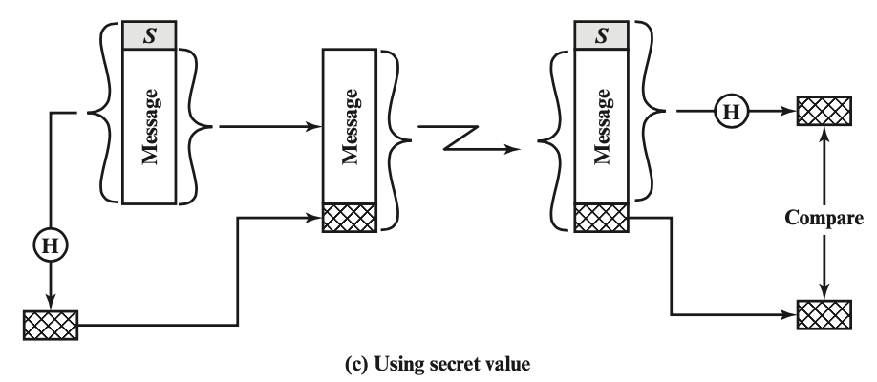
One use case - using hash function
Initialization: A and B share a common secret, S_{AB}
Message, M
A calculates MD_{M} = H (S_{AB} || M)
B recalculates MD’_{M}, and check
MD’_{M} = MD_{M}
This scheme cannot provide authentication.

Slide 110
Requirements for secure hash functions
1. can be applied to any sized message M
2. produces fixed-length output h
3. is easy to compute h=H(M) for any message M
4. given h is infeasible to find x s.t. H(x)=h
one-way property or preimage resistance
5. given x is infeasible to find x’ s.t. H(x’)=H(x)
weak collision resistance or second pre-image resistant
6. infeasible to find any pair of x,x’ s.t. H(x’)=H(x)
strong collision resistance

Slide 111
Hash Function: Collision Resistance
Collision: Two different inputs with the same output
x ≠ x' and H(x) = H(x')
Can we design a hash function with no collisions?
No, because there are more inputs than outputs (pigeonhole principle)
However, we want to make finding collisions infeasible for an attacker
Collision resistance: It is infeasible to (i.e. no polynomial time attacker can) find any pair of inputs x' ≠ x such that H(x) = H(x')

Slide 112
Secure hash function
A hash function that satisfies the first five properties is referred to as a weak hash function
Security: random/unpredictability, no predictable patterns for how changing the input affects the output
Changing 1 bit in the input causes the output to be completely different
Also called “random oracle” assumption
A message digest
a fixed size numeric representation of the contents of a message, computed by a hash function
Examples: SHA-1 (Secure Hash Algorithm 1), SHA-2, SHA-3, MD5

Slide 113
Hash Function: Examples
MD5
Output: 128 bits
Security: Completely broken
SHA-1
Output: 160 bits
Security: Completely broken in 2017
Was known to be weak before 2017, but still used sometimes
SHA-2
Output: 256, 384, or 512 bits (sometimes labeled SHA-256, SHA-384, SHA-512)
Not currently broken, but some variants are vulnerable to a length extension attack
Current standard
SHA-3 (Keccak)
Output: 256, 384, or 512 bits
Current standard (not meant to replace SHA-2, just a different construction)

Slide 114
Length Extension Attacks
Length extension attack: Given H(x) and the length of x, but not x, an attacker can create H(x || m) for any m of the attacker’s choosing
Length extension attack - Wikipedia
SHA-256 (256-bit version of SHA-2) is vulnerable
SHA-3 is not vulnerable

Slide 115
Lecture 17

Slide 116
Length Extension Attacks
Length extension attack: Given H(x) and the length of x, but not x, an attacker can create H(x || m) for any m of the attacker’s choosing
Length extension attack - Wikipedia
SHA-256 (256-bit version of SHA-2) is vulnerable
SHA-3 is not vulnerable

Slide 117
Does hashes provide integrity?
It depends on your threat model
Scenario
Mozilla publishes a new version of Firefox on some download servers
Alice downloads the program binary
How can she be sure that nobody tampered with the program?
Idea: use cryptographic hashes
Mozilla hashes the program binary and publishes the hash on its website
Alice hashes the binary she downloaded and checks that it matches the hash on the website
If Alice downloaded a malicious program, the hash would not match (tampering detected!)
An attacker can’t create a malicious program with the same hash (collision resistance)
Threat model: We assume the attacker cannot modify the hash on the website
We have integrity, as long as we can communicate the hash securely

Slide 118
Do hashes provide integrity?
It depends on your threat model
Scenario
Alice and Bob want to communicate over an insecure channel
David might tamper with messages
Idea: Use cryptographic hashes
Alice sends her message with a cryptographic hash over the channel
Bob receives the message and computes a hash on the message
Bob checks that the hash he computed matches the hash sent by Alice
Threat model: David can modify the message and the hash
No integrity!

Slide 119
Man-in-the-middle attack
M
M
M’
M’
MD
MD
MD’
MD’
Alice
David
Bob

Slide 120
Do hashes provide integrity?
It depends on your threat model
If the attacker can modify the hash, hashes don’t provide integrity
Main issue: Hashes are unkeyed functions
There is no secret key being used as input, so any attacker can compute a hash on any value

Slide 121
Solutions
A message digest created using a secret symmetric key is known as a Message Authentication Code (MAC), because it can provide assurance that the message has not been modified
The sender can also generate a message digest and then encrypt the digest using the private key of an asymmetric key pair, forming a digital signature. The signature must then be verified by the receiver through comparing it with a locally generated digest

Slide 122
Hashes: Summary
Map arbitrary-length input to fixed-length output
Output is deterministic
Security properties
One way: Given an output y, it is infeasible to find any input x such that H(x) = y.
Second preimage resistant: Given an input x, it is infeasible to find another input x' ≠ x such that H(x) = H(x').
Collision resistant: It is infeasible to find another any pair of inputs x' ≠ x such that H(x) = H(x').
Some hashes are vulnerable to length extension attacks
Hashes don’t provide integrity (unless you can publish the hash securely)

Slide 123
Lecture 17

Slide 124
Length Extension Attacks
Length extension attack: Given H(x) and the length of x, but not x, an attacker can create H(x || m) for any m of the attacker’s choosing
Length extension attack - Wikipedia
SHA-256 (256-bit version of SHA-2) is vulnerable
SHA-3 is not vulnerable

Slide 125
Does hashes provide integrity?
It depends on your threat model
Scenario
Mozilla publishes a new version of Firefox on some download servers
Alice downloads the program binary
How can she be sure that nobody tampered with the program?
Idea: use cryptographic hashes
Mozilla hashes the program binary and publishes the hash on its website
Alice hashes the binary she downloaded and checks that it matches the hash on the website
If Alice downloaded a malicious program, the hash would not match (tampering detected!)
An attacker can’t create a malicious program with the same hash (collision resistance)
Threat model: We assume the attacker cannot modify the hash on the website
We have integrity, as long as we can communicate the hash securely

Slide 126
Do hashes provide integrity?
It depends on your threat model
Scenario
Alice and Bob want to communicate over an insecure channel
David might tamper with messages
Idea: Use cryptographic hashes
Alice sends her message with a cryptographic hash over the channel
Bob receives the message and computes a hash on the message
Bob checks that the hash he computed matches the hash sent by Alice
Threat model: David can modify the message and the hash
No integrity!

Slide 127
Man-in-the-middle attack
M
M
M’
M’
MD
MD
MD’
MD’
Alice
David
Bob

Slide 128
Do hashes provide integrity?
It depends on your threat model
If the attacker can modify the hash, hashes don’t provide integrity
Main issue: Hashes are unkeyed functions
There is no secret key being used as input, so any attacker can compute a hash on any value

Slide 129
Solutions
A message digest created using a secret symmetric key is known as a Message Authentication Code (MAC), because it can provide assurance that the message has not been modified
The sender can also generate a message digest and then encrypt the digest using the private key of an asymmetric key pair, forming a digital signature. The signature must then be verified by the receiver through comparing it with a locally generated digest

Slide 130
Hashes: Summary
Map arbitrary-length input to fixed-length output
Output is deterministic
Security properties
One way: Given an output y, it is infeasible to find any input x such that H(x) = y.
Second preimage resistant: Given an input x, it is infeasible to find another input x' ≠ x such that H(x) = H(x').
Collision resistant: It is infeasible to find another any pair of inputs x' ≠ x such that H(x) = H(x').
Some hashes are vulnerable to length extension attacks
Hashes don’t provide integrity (unless you can publish the hash securely)

Slide 131
Lecture 18

Slide 132
Message Authentication Code

Slide 133
Message authentication code (MAC)
generated by an algorithm that creates a small fixed-sized block
depending on both message and some key
not be reversible
MAC_{M} = F(K_{AB}, M)
appended to message as a signature
receiver performs same computation on message and checks it matches the MAC
provides assurance that message is unaltered and comes from sender

Slide 134
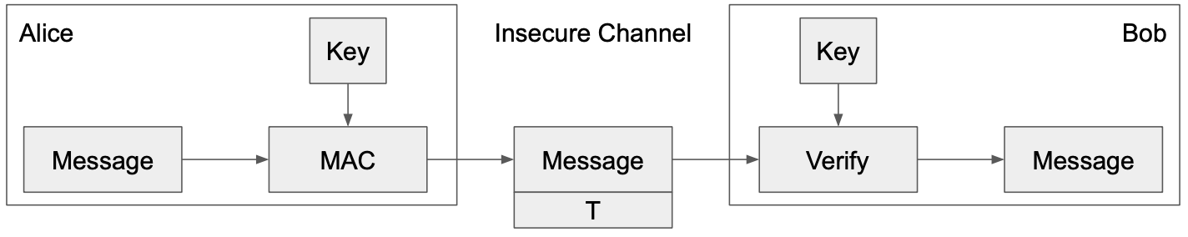
MACs: Usage
Alice wants to send M to Bob, but doesn’t want David to tamper with it
Alice sends M and T = MAC(K, M) to Bob
Bob receives M and T
Bob computes MAC(K, M) and checks that it matches T
If the MACs match, Bob is confident the message has not been tampered with (integrity)

Slide 135
MACs: Definition
Two parts:
KeyGen() → K: Generate a key K
MAC(K, M) → T: Generate a tag T for the message M using key K
Inputs: A secret key and an arbitrary-length message
Output: A fixed-length tag on the message
Properties
Correctness: Determinism
Note: Some more complicated MAC schemes have an additional Verify(K, M, T) function that don’t require determinism, but this is out of scope
Efficiency: Computing a MAC should be efficient
Security: existentially unforgeable under chosen plaintext attack

Slide 136
Existentially unforgeable
A secure MAC is existentially unforgeable: without the key, an attacker cannot create a valid tag on a message
David cannot generate MAC(K, M') without K
David cannot find any M' ≠ M such that MAC(K, M') = MAC(K, M)

Slide 137
Example: HMAC
issued as RFC 2104 [1]
has been chosen as the mandatory-to-implement MAC for IP Security
Used in Transport Layer Security (TLS) and Secure Electronic Transaction (SET)
[1] “HMAC: Keyed-Hashing for Message Authentication”, RFC 2104, https://datatracker.ietf.org/doc/html/rfc2104

Slide 138
HMAC(K, M)
will produce two keys to increase security
If key is longer than the desired size, we can hash it first, but be careful with using keys that are too much smaller, they have to have enough randomness in them
Output H[(K⁺ ⊕ opad) || H[(K⁺ ⊕ ipad) || M]]

Slide 139
Example: HMAC
HMAC(K, M):
Output H[(K⁺ ⊕ opad) || H[(K⁺ ⊕ ipad) || M]]
Use K to derive two different keys
opad (outer pad) is the hard-coded byte 0x5c repeated until it’s the same length as K⁺
ipad (inner pad) is the hard-coded byte 0x36 repeated until it’s the same length as K⁺
As long as opad and ipad are different, you’ll get two different keys
For paranoia, the designers chose two very different bit patterns, even though they theoretically need only differ in one bit

Slide 140
Lecture 19

Slide 141
Outline
Review of MAC authentication
Authenticated encryption

Slide 142
HMAC Properties
HMAC(K, M) = H[(K⁺ ⊕ opad) || H((K⁺ ⊕ ipad) || M]]
HMAC is a hash function, so it has the properties of the underlying hash too
It is collision resistant
Given HMAC(K, M), an attacker can’t learn M – one way
If the underlying hash is secure, HMAC doesn’t reveal M, but it is still deterministic
You can’t verify a tag T if you don’t have K
This means that an attacker can’t brute-force the message M without knowing K

Slide 143
MACs: Summary
Inputs: a secret key and a message
Output: a tag on the message
A secure MAC is unforgeable: Even if David can trick Alice into creating MACs for messages that David chooses, David cannot create a valid MAC on a message that she hasn't seen before
Example: HMAC(K, M) = H((K⁺ ⊕ opad) || H((K⁺ ⊕ ipad) || M))
MACs do not provide confidentiality

Slide 144
Do MACs provide integrity?
Do MACs provide integrity?
Yes. An attacker cannot tamper with the message without being detected
Do MACs provide authenticity?
It depends on your threat model
If only two people have the secret key, MACs provide authenticity: it has a valid MAC, and it’s not from me, so it must be from the other person
More than one secret key, If a message has a valid MAC, you can be sure it came from someone with the secret key, but you can’t narrow it down to one person
Do MACs provide confidentiality?

Slide 145
Authenticated Encryption

Slide 146
Authenticated Encryption: Definition
Authenticated encryption (AE): A scheme that simultaneously guarantees confidentiality and integrity (and authenticity, depending on your threat model) on a message
Two ways of achieving authenticated encryption:
Combine schemes that provide confidentiality with schemes that provide integrity
Use a scheme that is designed to provide confidentiality and integrity

Slide 147
Scratchpad: Let’s design it together
You can use:
An encryption scheme (e.g. AES-CBC): Enc(K, M) and Dec(K, M)
An unforgeable MAC scheme (e.g. HMAC): MAC(K, M)
First attempt: Alice sends Enc(K1, M) and MAC(K2, M)
Integrity? Yes, attacker can’t tamper with the MAC
Confidentiality? No, the MAC is not secure
Idea 1: Let’s compute the MAC on the ciphertext instead of the plaintext: Enc(K1, M) and MAC(k2, Enc(K1, M))
Integrity? Yes, attacker can’t tamper with the MAC
Confidentiality? Yes, the MAC might leak info about the ciphertext, but that’s okay
Idea 2: Let’s encrypt the MAC too: Enc(K1, M || MAC(K2, M))
Integrity? Yes, attacker can’t tamper with the MAC
Confidentiality? Yes, everything is encrypted

Slide 148
MAC-then-Encrypt or Encrypt-then-MAC?
Method 1: Encrypt-then-MAC
First compute Enc(K1, M)
Then MAC the ciphertext: MAC(K2, Enc(K1, M))
Method 2: MAC-then-encrypt
First compute MAC(K2, M)
Then encrypt the message and the MAC together: Enc(k1, M || MAC(K2, M))
Which is better?
In theory, both are secure if applied properly
MAC-then-encrypt has a flaw: You don’t know if tampering has occurred until after decrypting
Attacker can supply arbitrary tampered input, and you always have to decrypt it
Passing attacker-chosen input through the decryption function can cause side-channel leaks
Always use encrypt-then-MAC because it’s more robust to mistakes

Slide 149
Lecture 20

Slide 150
MAC-then-Encrypt or Encrypt-then-MAC?
Method 1: Encrypt-then-MAC
First compute Enc(K1, M)
Then MAC the ciphertext: MAC(K2, Enc(K1, M))
Method 2: MAC-then-encrypt
First compute MAC(K2, M)
Then encrypt the message and the MAC together: Enc(k1, M || MAC(K2, M))
Which is better?
In theory, both are secure if applied properly
MAC-then-encrypt has a flaw: You don’t know if tampering has occurred until after decrypting
Attacker can supply arbitrary tampered input, and you always have to decrypt it
Passing attacker-chosen input through the decryption function can cause side-channel leaks
Always use encrypt-then-MAC because it’s more robust to mistakes

Slide 151
TLS 1.0 “Lucky 13” Attack
TLS: A protocol for sending encrypted and authenticated messages over the Internet
TLS 1.0 uses MAC-then-encrypt: Enc(k1, M || MAC(k2, M))
The encryption algorithm is AES-CBC
The Lucky 13 attack abuses MAC-then-encrypt to read encrypted messages
Guess a byte of plaintext and change the ciphertext accordingly
The MAC will error, but the time it takes to error is different depending on if the guess is correct
Attacker measures how long it takes to error in order to learn information about plaintext
TLS will send the message again if the MAC errors, so the attacker can guess repeatedly
Takeaways
Side channel attack: The algorithm is proved secure, but poor implementation made it vulnerable
Always encrypt-then-MAC
https://medium.com/@c0D3M/lucky-13-attack-explained-dd9a9fd42fa6

Slide 152
Authenticated Encryption: Summary
Authenticated encryption: A scheme that simultaneously guarantees confidentiality and integrity (and authenticity) on a message
First approach: Combine schemes that provide confidentiality with schemes that provide integrity and authenticity
MAC-then-encrypt: Enc(K1, M || MAC(K2, M))
Encrypt-then-MAC: MAC(K2, Enc(K1, M))
Always use Encrypt-then-MAC because it's more robust to mistakes

Slide 153
Digital Signature

Slide 154
Digital Signatures
NIST FIPS PUB 186-4 - the result of a cryptographic transformation of data that, when properly implemented, provides a mechanism for verifying origin authentication, data integrity, and signatory non-repudiation
Based on asymmetric keys

Slide 155
Digital Signatures
Asymmetric cryptography is good because we don’t need to share a secret key
Digital signatures are the asymmetric way of providing integrity/authenticity to data
Assume that Alice and Bob can communicate public keys without David interfering

Slide 156
Digital Signatures: Definition
Three parts:
KeyGen() → PK, SK: Generate a public/private keypair, where PK is the verify (public) key, and SK is the signing (secret) key
Sign(SK, M) → sig: Sign the message M using the signing key SK to produce the signature sig
Verify(PK, M, sig) → {0, 1}: Verify the signature sig on message M using the verify key PK and output 1 if valid and 0 if invalid
Properties:
Correctness: Verification should be successful for a signature generated over any message
Verify(PK, M, Sign(SK, M)) = 1 for all PK, SK ← KeyGen() and M
Efficiency: Signing/verifying should be fast
Security: Same as for MACs except that the attacker also receives PK
Namely, no attacker can forge a signature for a message

Slide 157
Lecture 20

Slide 158
MAC-then-Encrypt or Encrypt-then-MAC?
Method 1: Encrypt-then-MAC
First compute Enc(K1, M)
Then MAC the ciphertext: MAC(K2, Enc(K1, M))
Method 2: MAC-then-encrypt
First compute MAC(K2, M)
Then encrypt the message and the MAC together: Enc(k1, M || MAC(K2, M))
Which is better?
In theory, both are secure if applied properly
MAC-then-encrypt has a flaw: You don’t know if tampering has occurred until after decrypting
Attacker can supply arbitrary tampered input, and you always have to decrypt it
Passing attacker-chosen input through the decryption function can cause side-channel leaks
Always use encrypt-then-MAC because it’s more robust to mistakes

Slide 159
TLS 1.0 “Lucky 13” Attack
TLS: A protocol for sending encrypted and authenticated messages over the Internet
TLS 1.0 uses MAC-then-encrypt: Enc(k1, M || MAC(k2, M))
The encryption algorithm is AES-CBC
The Lucky 13 attack abuses MAC-then-encrypt to read encrypted messages
Guess a byte of plaintext and change the ciphertext accordingly
The MAC will error, but the time it takes to error is different depending on if the guess is correct
Attacker measures how long it takes to error in order to learn information about plaintext
TLS will send the message again if the MAC errors, so the attacker can guess repeatedly
Takeaways
Side channel attack: The algorithm is proved secure, but poor implementation made it vulnerable
Always encrypt-then-MAC
https://medium.com/@c0D3M/lucky-13-attack-explained-dd9a9fd42fa6

Slide 160
Authenticated Encryption: Summary
Authenticated encryption: A scheme that simultaneously guarantees confidentiality and integrity (and authenticity) on a message
First approach: Combine schemes that provide confidentiality with schemes that provide integrity and authenticity
MAC-then-encrypt: Enc(K1, M || MAC(K2, M))
Encrypt-then-MAC: MAC(K2, Enc(K1, M))
Always use Encrypt-then-MAC because it's more robust to mistakes

Slide 161
Digital Signature

Slide 162
Digital Signatures
NIST FIPS PUB 186-4 - the result of a cryptographic transformation of data that, when properly implemented, provides a mechanism for verifying origin authentication, data integrity, and signatory non-repudiation
Based on asymmetric keys

Slide 163
Digital Signatures
Asymmetric cryptography is good because we don’t need to share a secret key
Digital signatures are the asymmetric way of providing integrity/authenticity to data
Assume that Alice and Bob can communicate public keys without David interfering

Slide 164
Digital Signatures: Definition
Three parts:
KeyGen() → PK, SK: Generate a public/private keypair, where PK is the verify (public) key, and SK is the signing (secret) key
Sign(SK, M) → sig: Sign the message M using the signing key SK to produce the signature sig
Verify(PK, M, sig) → {0, 1}: Verify the signature sig on message M using the verify key PK and output 1 if valid and 0 if invalid
Properties:
Correctness: Verification should be successful for a signature generated over any message
Verify(PK, M, Sign(SK, M)) = 1 for all PK, SK ← KeyGen() and M
Efficiency: Signing/verifying should be fast
Security: Same as for MACs except that the attacker also receives PK
Namely, no attacker can forge a signature for a message

Slide 165
Lecture 21

Slide 166
RSA Signature
KeyGen():
Randomly pick two large primes, p and q
Compute n = pq
n is usually between 2048 bits and 4096 bits long
Choose e
Requirement: e is relatively prime to (p - 1)(q - 1)
Requirement: 2 < e < (p - 1)(q - 1)
Compute d = e⁻¹ mod (p - 1)(q - 1)
Public key: n and e
Private key: d

Slide 167
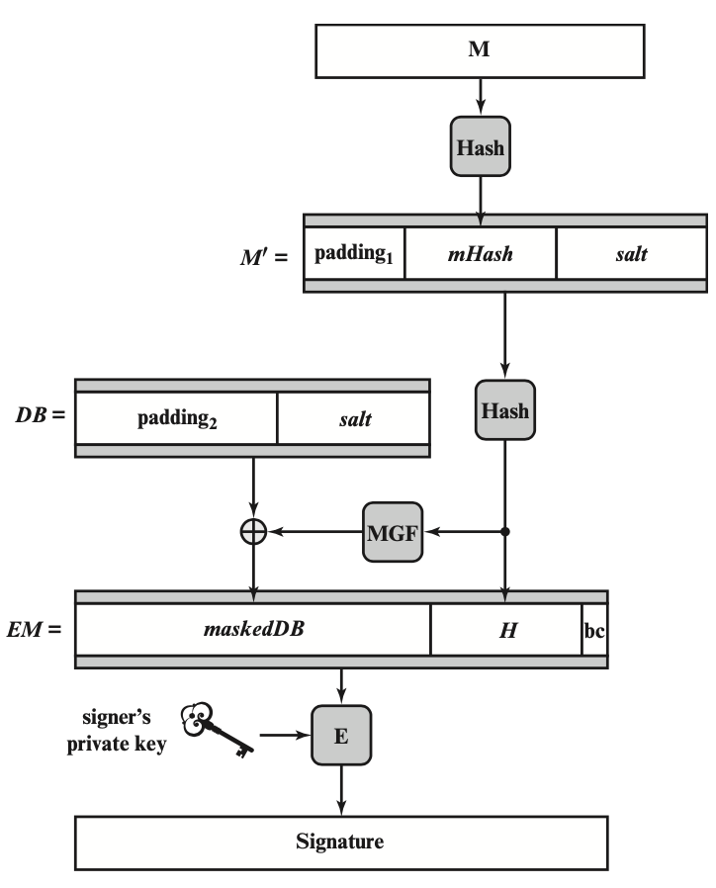
RSA Digital Signature Algo
Step1: Generate a hash value, or message digest, mHash from the message M to be signed
Step2: Pad mHash with a constant value padding1 and pseudorandom value salt to form M’
Step3: Generate hash value H from M’
Step4: Generate a block DB consisting of a constant value padding 2 and salt
Step5: Use the mask generating function MGF, which produces a randomized out-put from input H of the same length as DB
Step 6: Create the encoded message (EM) block by padding H with the hexadecimal constant bc and the XOR of DB and output of MGF
Step 7: Encrypt EM with RSA using the signer’s private key

Slide 168
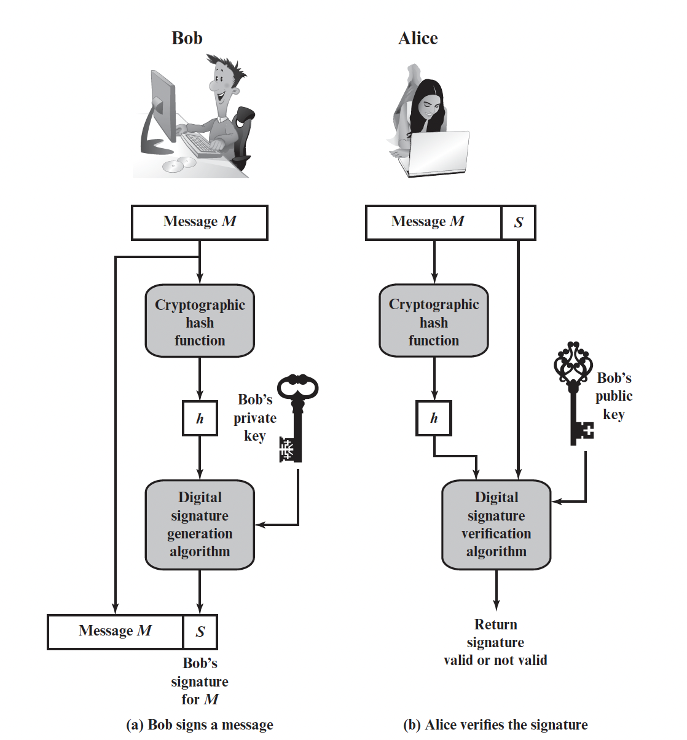
RSA Signatures
Sign(d, M):
Compute H(M)^{d} mod n
Verify(e, n, M, sig)
Verify that H(M) ≡ sig^{e} mod n

Slide 169
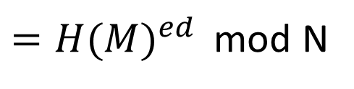
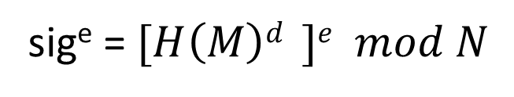
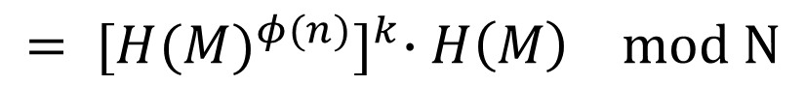

RSA Signatures: Correctness
Theorem: sig^{e} ≡ H(M) mod N
Proof:
sig^{e} = ${[H\left(M\right)d}^{ }]e mod N$
$={H(M)}^{ed }$ mod N
${=H(M)}^{kφ\left(n\right)+1}$ mod N
$${= [{H(M)}^{φ(n)}]}^{k}∙H\left(M\right) mod N$$
= H(M) mod N

Slide 170
RSA Digital Signature: Security
Necessary hardness assumptions:
Factoring hardness assumption: Given n large, it is hard to find primes pq = n
Discrete logarithm hardness assumption: Given n large, hash, and hash^{d} mod n, it is hard to find d
Salt also adds security
Even the same message and private key will get different signatures

Slide 171
Hybrid Encryption
Issues with public-key encryption
Notice: We can only encrypt small messages because of the modulo operator
Notice: There is a lot of math, and computers are slow at math
Result: We don’t use asymmetric for large messages
Hybrid encryption: Encrypt data under a randomly generated key K using symmetric encryption, and encrypt K using asymmetric encryption
Enc_{Asym}(PK, K); Enc_{Sym}(K, large message)
Benefit: Now we can encrypt large amounts of data quickly using symmetric encryption, and we still have the security of asymmetric encryption

Slide 172
Homework – no submission
RQ: 3.1, 3.2, 3.3, 3.4, 3.6, 3.7
Problems:
prove correctness of RSA digital signature
3.14

Slide 173
Homework 2 - individual
For Chapter 3
Deadline: Oct. 26 (Thursday), 11:59 pm
We will use the blackboard submission time as your final timestamp
10% penalty per day for late submission

Slide 174
Network Security Requirements

Slide 175
Network Security
Definition: The protection afforded to an automated information system in order to attain the application objectives to preserving the integrity, availability, and confidentiality of information system resources (includes hardware, software, firmware, information/data, and telecommunications).
- NIST Computer Security Handbook

Slide 176
Confidentiality
Data confidentiality: Assures that private or confidential information is not made available or disclosed to unauthorized individuals;
Privacy: Assures that individual's control or influence what information related to them may be collected and stored and by whom and to whom that information may be disclosed
i.e., student grade information

Slide 177
Integrity
Data integrity: Assures that data (both stored and in transmitted packets) and programs are changed only in a specified and authorized manner;
System integrity: Assures that a system performs its intended function in an unimpaired manner, free from deliberate or inadvertent unauthorized manipulation of the system
i.e., a hospital patient’s allergy information

Slide 178
Availability
Availability: Assures that systems work promptly, and service is not denied to authorized users, ensuring timely and reliable access to and use of information
i.e., denial of service attack

Slide 179

Other security requirements
Authenticity
Accountability
tracible data source,
fault isolation
intrusion detection and prevention,
recovery and legal action
system must keep records of their activities to permit later forensic analysis to trace security breaches or to aid in transaction disputes

Slide 180
Question
What security requirements does a blockchain system have achieved?

Slide 181
Project
Task1: OnDemand Professor Q&A Bot
Your task is to build a Q&A Bot over private data that answers questions about the network security course using the open-source alternatives to ChatGPT that can be run on your local machine. Data privacy can be compromised when sending data over the internet, so it is mandatory to keep it on your local system.
Your Q&A Bot should be able to understand user questions and provide appropriate answers from the local database, then the citations should be added (must be accomplished) if the response is from the internet, then the web references should be added.
Train your bot using network security lecture slides, network security textbook, and the Internet.
By using Wireshark capture data for Step 4's of the LLM workflow shown in Figure 1. Provide detailed explanations of the trace data. Also, Maintain a record of Step 1's prompt and its mapping to the trace data in Step 4's.
Task2: Quiz Bot
Your task is to build a quiz bot based on a network security course using the open-source alternatives to ChatGPT that can be run on your local machine. Data privacy can be compromised when sending data over the internet, so it is mandatory to keep it on your local system.
Two types of questions should be offered by the bot: randomly generated questions and specific topic questions and the answers should be pulled from the network security database. Train your bot using network security quizzes, lecture slides, network security textbook, and the Internet.
The quiz must include multiple-choice questions, true/false questions, and open-ended questions.
Finally, the bot should be able to provide feedback on the user's answers.

Slide 182


Slide 183
Form Project Groups
Form a group (no submission)
The project will be assigned as a group project. Six students will be considered a group for a project. Here is the link to enter your project group member names.
FALL 2023 CS5342 PROJECT GROUP NAMES.xlsx
It is recommended that one person in the group fills in the form to avoid multiple entries and submits project files on Blackboard. If you cannot get a group, contact to TA.
Deadline to submit your group members is 11:59PM on Sept 8th, 2023

Slide 184
Email communication
Email subject: course# _course name_reason
such as “CS 5342_network security_late submission”

